Slide 1

Your recruiter and you..
Pros v Joes
Second Order Chaos
@2OCStream
How to work with a recruiter effectively to build your career.

Slide 2
Engagement : Your recruiter and you
Introduction: /whoami /ipconfig all
What recruiters do: Brief understanding of what we do
Know your recruiter: How to know if your recruiter is the one!
How to work WITH your recruiter: Help them help you
Your career: Short v Medium v Long Term Career decisions
Things to remember: Tips/Summary
Questions: Make em good!

Slide 3
Your recruiter and you.
Introduction
/whoami /ipconfig all

Slide 4
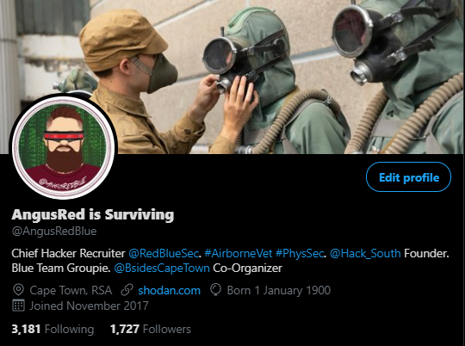

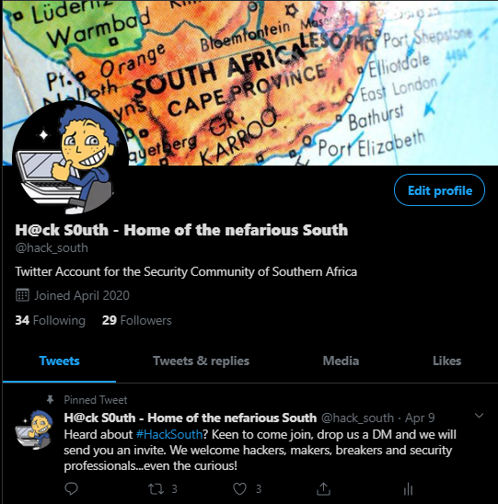
Introduction – $ career/ ls -l
Charles H Wroth
*6 Years: Former British Airborne (3 PARA) UK
*6 Years :High Risk Security Advisor (PhysSec)
-O&G
-Mining and Minerals
-Anti-Piracy
-HECPO
-Coxswain
-Team Medic
*3 Years: Technical Security Recruiter
-Technically advanced security hiring (USA, UK, RSA)
-B Sides Cape Town Co-Organizer (Logistics)
-Hack South Founder/Root
-TMHC Chief Shitposter/Destroyer of Dreams (Recently MOD)
-Working to become a DFIR Consultant
-Noob level CTF’er aka BASE64 Decoder
Notes:
What you do for a living.

Slide 5
Your recruiter and you.
What recruiters do What, how and why?

Slide 6
What recruiters do. Why?
The Job
The Search
The Moneys
Billable Client
Pre Bill
Contingency
Retainer
Desk Fee
Commission on Target
WHY USE A RECRUITER?
Why I do it?
The money
The subject
The moral aspect
Notes:
THE JOB
-We get asked to help companies, find the talent their internal teams cant find.
The Search
-We find people using various things. Job boards, LI, used to try use IRC, Twitter. Etc
The Moneys
-What do we earn? This is VERY Complex
DIRECT HIRING
Percentage based on first years compensation, excluding stock, bonuses or perks.
5.5% - 50%
Charge to company
Apply Desk Fee
Apply target
Reached target? Get Comm
Small Salary
WHY USE A RECRUITER
-We are like your career lawyers
-A single recruiter can often pitch you various roles, saves you the hassle
-A GOOD recruiter will consider your career aspirations and career path, and SUPPORT IT
-A GOOD recruiter will be honest, frank and open about the client they are pitching you to, ESP if they have placed there.
-Job creation.
This is what drives bad hiring practices. Pushing recruiters to do X amount of calls per day is not a metric for measuring success.
Money
-When I make money, I make decent money
Subject
-I LOVE INFOSEC
MORAL
-Bringing opportunity to people, and seeing the effect it has on their lives.

Slide 7
Your recruiter and you.
Know your recruiter
How to know if your recruiter is the one!

Slide 8
Know your recruiter. How to know if your recruiter is the one!
Are they interested in who you are (Bigger picture)
What your story is
Who you are
What your motivations are
Do they ACTUALLY understand what you do, at least at a high level?
What are their motivations?
How they communicate
Are you a filler, or seen as a potential valued asset?
Do they make mistakes?
Notes:
So how do you know if the recruiter you are using or the recruiter that has contacted you is the right one?
ARE THE INTERESTED IN WHO YOU ARE
HOW THE COMMUNICATE?
Often recruiter will use basic templates to interact with people. This should be understood and respected. Like you will run a NMAP scan, recruiters will run searches looking for suitable people. Did they contact you about a gig that is applicable to you?
Do they show you respect?
DO THEY LISTEN?
If you ask them about who the client is, or what it pays, understand that they wont always be able to say. This however MUST be covered on your clearing call. If you have rapport with the recruiter, or with me for e.g., if I have spoken with you before or represented you, I will probably tell you straight off the bat?
Why wont a recruiter tell you who the company is?
FILLER
Do they make you feel like you are mearly a means to plugging a whole? Or do they sound like they support your career? That they are considerate?
Do they make mistakes?
If a recruiter accidently sends you the wrong email, don’t crucify them.
If they accidently make a error in booking an interview, don’t smite them.
We are hooman, hooman makes mistakes.
IF they do screw up big, and don’t apologize to you, then do as you wish.

Slide 9
Your recruiter and you.
How to work WITH your recruiter
Help them help you

Slide 10
How to work WITH your recruiter Help them help you
Speaking foreign
If they are a technical recruiter
If they are NOT a technical recruiter
Communication
Flatlining
Circumvention
Circumstance changes
Advancing process
Accepting an offer elsewhere
Say thanks
PRESSURE
Listen
You know yourself better than anyone, they know the client better than anyone
The messenger said sorry
Questions
Ask the questions on your mind
Sorry, no answer
Advice (Client, Resume, Career)
Commitment
As the hiring manager
As the candidate
Money talk
Notes:
SPEAKING FOREIGN
-Technical recruiters, like me, tend to understand what you are talking about. Get technical, within reason
-None Tech recruiter: Be gentle, take it easy, teach them something, don’t school them.
COMMUNICATION
-Flatlining // If your recruiter is decent, don’t flatline them.
-CIRCUMVENTION // Usually, someone can take a JD sent to them and reverse search it, to find the origin. What do you have to gain from that? We will most likely still get paid.
-Circumstances // If your circumstances change, or motivation, TELL US!
-Advancing Process // If you are proceeding to advanced stages with another company, TELL US! We will expadite, and then you may have multiple options to consider.
-Accepting an Offer // IF you plan to accept an offer, TELL US, if we cant compete, we will congratulate you.
-Say Thanks // If we added value to you, job or no job, consider saying thanks? Maybe?
-PRESSURE // If a recruiter is pushing and pressuring you to interview or accept an offer, walk away. Pressure and giving advice are 2 different things
LISTEN
-We know our clients. We know what they are looking for, and what they are not looking for. Listen to us, hear us out. If we tell you, that you don’t fit, respect that.
-The Messenger: We play middleman. If the client rejects you, don’t take it out on us. A good recruiter will attempt to get feedback, but that is not always possible. A GOOD Client will post feedback. There is no point in fighting it. Getting shitty with a recruiter will not change the fate.
QUESTIONS
-Ask what you need to know, but remember, we don’t always have the answers
-For senior/Exec level roles, remember, the job might be there to answer the questions.
COMMITMENT
-Commit to the hire
-Commit to the interview
MONEY TALK

Slide 11
Your recruiter and you.
Your career
The Short, the medium and the long

Slide 12
Your career Considerations on your Short, Medium and Long term career.
Short term gain?
Base Salary
Benefits
Perks
Travel/Location/Relocation
PSU/RSU, Equity, Stocks
Medium Term
What skills and exp will I gain in this position?
Long term gain
What value will this job bring to my career?
How will this title look on my resume/LinkedIn
What value does this add to my future?

Slide 13
Your recruiter and you.
Things to remember
Summary

Slide 14
Things to remember Summary
We is human
Rejection is shared and felt
Communications
Help us, help you
Make wise career decisions
Notes:
We are human, we make mistakes
Rejection: Recruiting is often a thankless job. We handle rejection on a daily basis. Yes most of us have tough skin, but its not always easy, so don’t be evil, be kind.
Communications: If you have a recruiter you trust, be open with them about money, about aspirations, about concerns.
Help us, help you: Work with us, use us, ask us. We are here to help you.
Make wise: Consider the short, medium and long term gain when accepting/declining a job.

Slide 15
Your recruiter and you.
Questions!
Speak now or forever hold your peace

Slide 16




I Recruit Hackers
@AngusRedBlue
@hack_south
https://github.com/AngusRed
/in/chwroth/
HTB User/195578
Socials
Find me!

Slide 17

Thanks!

